Slide 1

Experimental comparison of syntax and semantics of DBS Oracle and MySQL
Michal Kvet
Lucia Fidesová
FRUCT – 7 – 11. 11. 2016, Finland

Slide 2
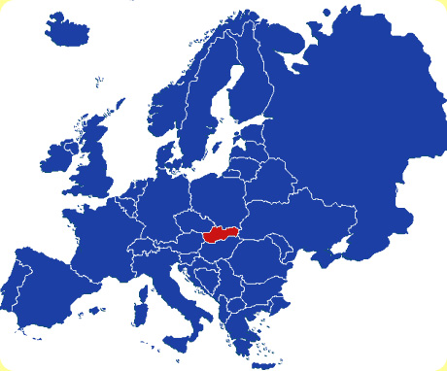
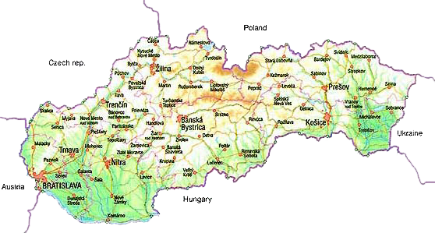
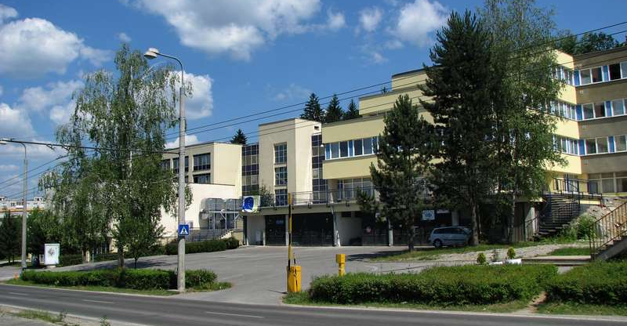
Slovakia, university

Slide 3

Introduction
Development of almost any information system requires management of data stored in the database.
  data amount
  time limited validity
  storing whole time spectrum
  sensor data processing
Why temporal data?
  decision making
  analysis
  creating future prognoses,
  progress of the changes monitoring,
  reduce amount of data to be transferred and processed,
  ....
performance

Slide 4
Analysis
Several types of database systems
  managing, storing, modifying and selecting large data amounts.
    transport systems, industry, medicine, business applications, …
  Database administration – relational databases
    Oracle
    MySQL
    PostgreSQL
    Informix
    DB2
based on SQL
=> own dialect
syntax & semantics
performance limitations & definitions

Slide 5


History (1)
Development of relational database management system began in the 60s of the 20th century.
File systems
Hierarchical and network based DBS
Relational DBS (Edgar Codd, 70s)
Object oriented DBS
NoSQL
Large data amounts

Slide 6


History (2)
Properly designed structure is the basis for the optimization and efficient processing.
Temporality (backups, log files)
Index structures
Function processing
Object level vs. Column level temporal architecture
time

Slide 7
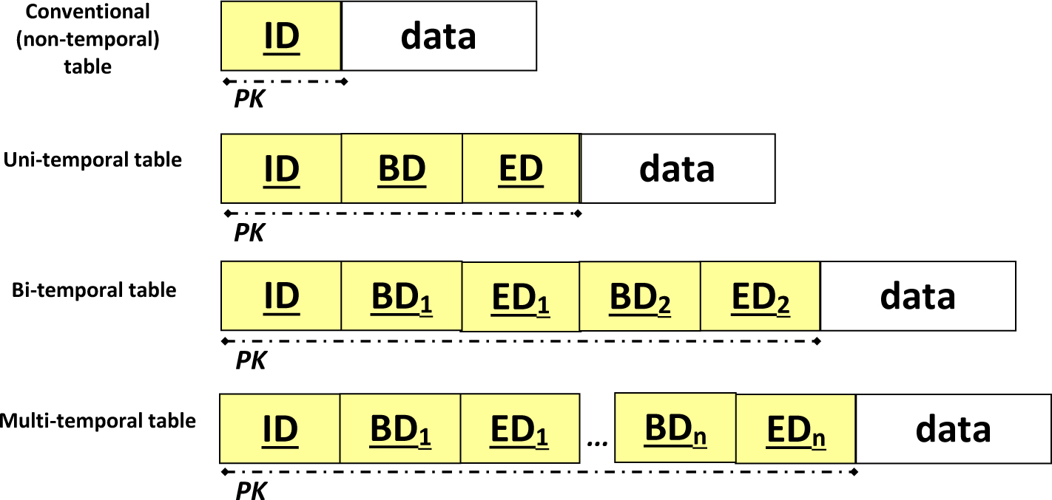
Models (object level)
Temporal model
vs.
Conventional model with temporal attributes
Validity,
Transaction validity,
Time locality,
Reliability,
...
Or BD only – each state delimits the validity of previous one

Slide 8

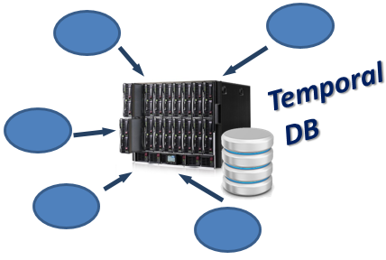
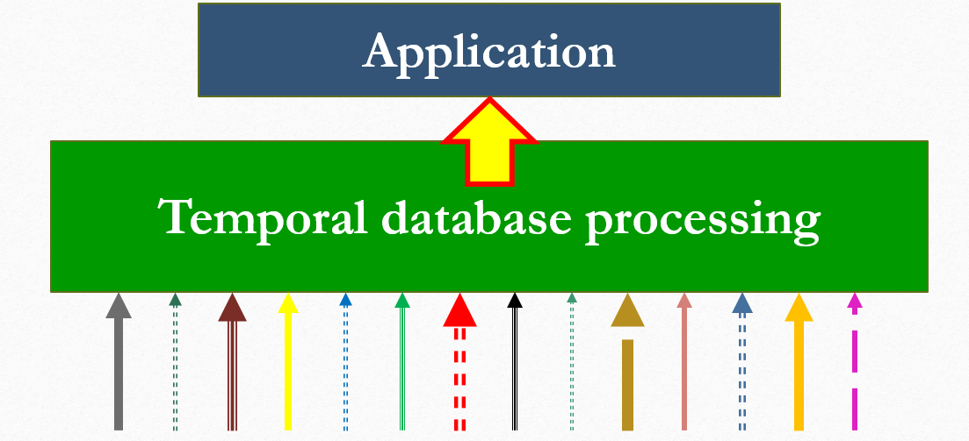
Temporality
Operations:
  Insert,
  Update,
  Delete
  Restore,
  Purge
  Select
  Such solution is inappropriate
  for sensor data processing!
Data:
Historical,
Actual,
Future valid

Slide 9
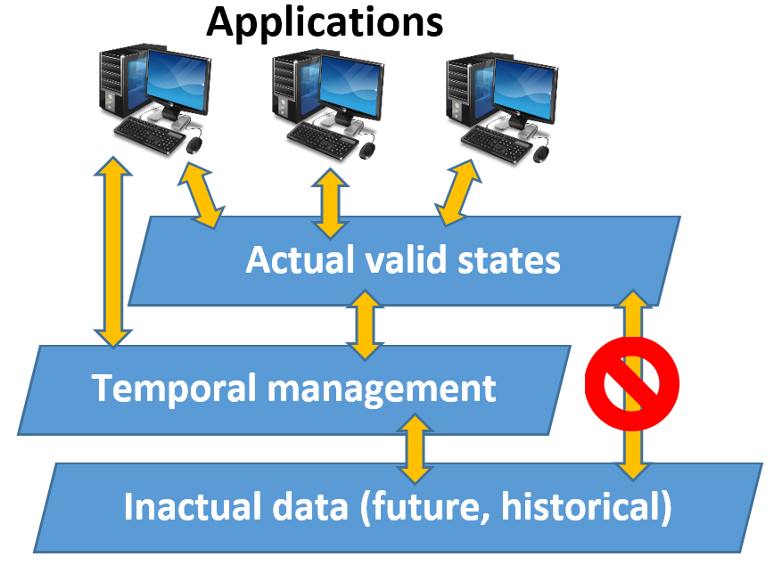
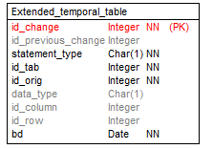
Attribute level temporal system
Consistency with existing systems
Data amount

Slide 10
MySQL vs. Oracle
Oracle database system is developed for wide range and wide amount of commercial data. In general, a server reliably manages a large amount of data in a multiuser environment so that many users can concurrently access the same data. All requirements are accomplished while delivering high performance. A database server also prevents unauthorized access and provides efficient solutions for failure recovery.
Vice versa, MySQL is one of the most favourite open-source DBS mostly provided by web applications.
When dealing with MySQL, it is worth to mention also MariaDB community, which has been founded by the original MySQL developers. They maintain high compatibility of MariaDB with MySQL.

Slide 11
Data types
Data type | Allocation (bytes) | Minimal value | Maximal value
 |  | With(out) sign | With(out) sign
TINYINT | 1 | -128 | 127
 |  | 0 | 255
SMALLINT | 3 | -32768 | 32767
 |  | 0 | 65535
MEDIUMINT | 3 | -8388608 | 8388607
 |  | 0 | 16777215
INTEGER (INT) | 4 | -2147483648 | 2147483647
 |  | 0 | 4294967295
BIGINT | 8 | -922337203 6854775808 | 92233720368 54775807
 |  | 0 | 184467440737 09551615
Numeric data types
Date and time data types
  MySQL – Date, Datetime, Timestamp
  Oracle – Date, Timestamp
String data types
MySQL | Size (in bytes) | Oracle
TINYINT | 1 | NUMBER(3,0)
SMALLINT | 2 | NUMBER(5,0)
MEDIUMINT | 3 | NUMBER(7,0)
INTEGER (INT) | 4 | NUMBER(10,0)
BIGINT | 8 | NUMBER(19,0)
DOUBLE | 8 | BINARY_FLOAT BINARY_DOUBLE
FLOAT(x<=24) | 4 | BINARY_FLOAT
FLOAT(25<=x<=53 | 8 | BINARY_FLOAT
DECIMAL, REAL | 8 | BINARY_FLOAT
Input data | CHAR(4) | Size | VARCHAR(4) | Size
‘’ | ‘’ | 4 bytes | ‘’ | 1 byte
‘ab’ | ‘ab’ | 4 bytes | ‘ab’ | 3 bytes
‘abcd’ | ‘abcd’ | 4 bytes | ‘abcd’ | 5 bytes
‘abcdef’ | ‘abcd’ | 4 bytes | ‘abcd’ | 5 bytes

Slide 12
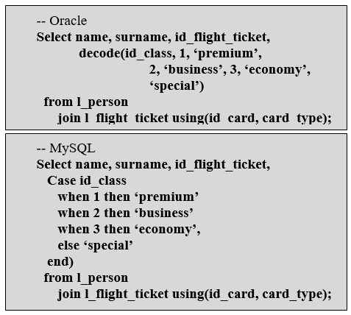
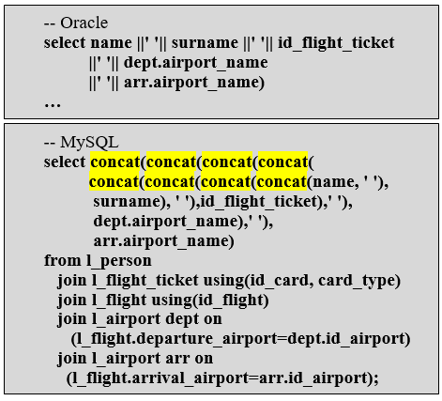
SQL
DDL (Data Definition Language)
DML (Data Manipulation Language)
DCL (Data Control Language)
TCL (Transaction Control Language)
1
2
3
4

Slide 13
Experiments - parameters
 | Machine 1 | Machine 2
CPU | Intel Core i7 4710HQ, 3300 MHz, 4 cores, 8 threads | Intel Core i5 4200M, 3100 MHz 2 cores, 4 threads
RAM | 16 GB | 8 GB
HDD | Samsung SSD 840 EVO SATA3 | Samsung SSD 850 EVO SATA3
OS | Windows 8.1 Pro | Windows 10 Pro
PHP | 7.0.0 64bit thread safe
MySQL | MySQL Community Edition 5.7.9
Oracle | Oracle Database 11g Express Edition Release 11.2.0.2.0 - 64bit
Multiple experiments have been performed and evaluated, we will highlight some specifics of proposed systems.
InnoDB, MyISAM

Slide 14
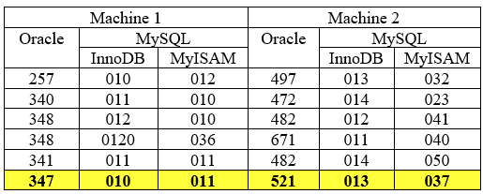
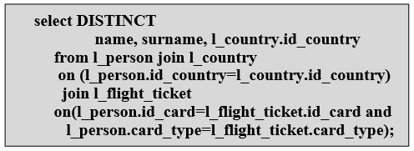
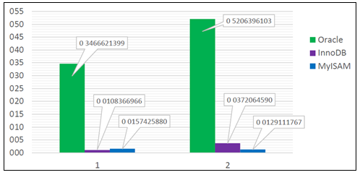
Experiment (1)
DISTINCT

Slide 15
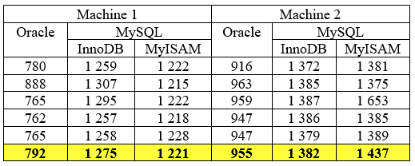
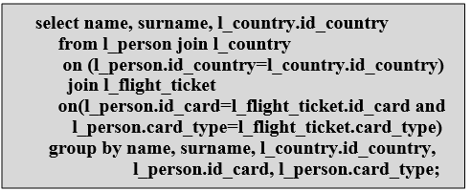
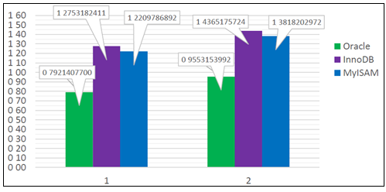
Experiment (2)
GROUP BY

Slide 16
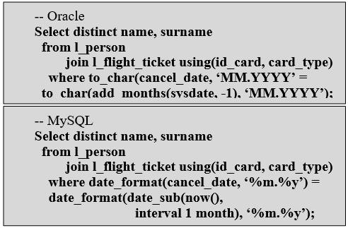
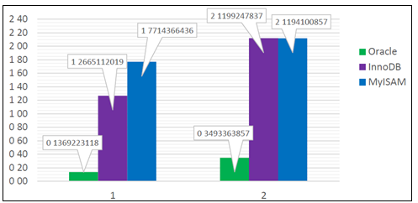
Experiment (3)
Oracle DBS performance provides following improvements: (MySQL is reference 100%):
Machine 1
  89, 27% (InnoDB)
  92, 26% (MyISAM)
Machine 2
  83, 54% (InnoDB)
  83, 53% (MyISAM)
DATE MANAGEMENT

Slide 17
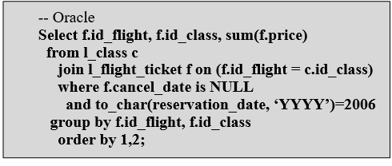
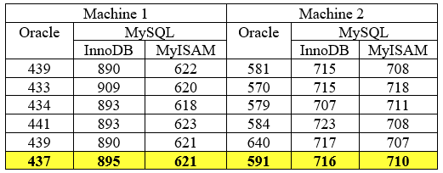
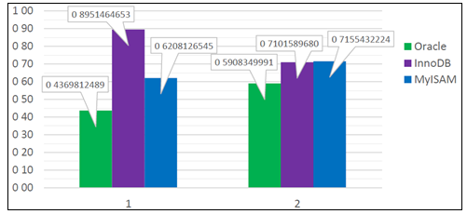
Experiment (4)
Based on experiments, performance improvement of Oracle DBS in comparison with MySQL is 51,17% (InnoDB reference 100%) and 29,63% (MyISAM reference 100%). When dealing with worse hardware characteristics, difference is not so significant:
16,76% (InnoDB reference 100%),
17,46% (MyISAM reference 100%).
AGGREGATE FUNCTIONS

Slide 18
Summary
Based on these experiments, we can say that in most cases Oracle database processing command requirements are less than a MySQL database (processing time). Database system Oracle, however, lags significantly in choosing unique record values provided by the DISTINCT feature.
It was further found that a change in the method of storing data in the MySQL database has greater impact on the experiments for machine 1 in comparison with machine 2.
When dealing with date formats, storage engine InnoDB je faster than MyISAM. On the other hand, when managing aggregate functions and ORDER BY clause in the Select statements, MyISAM is better choice.

Slide 19

Conclusion
Intelligent systems
  temporal changes locality, diversity and reliability
  large data amount
Temporal database
  object level
  attribute level
  Wide range of DBS systems
  various methods
Future:
  index distribution techniques,
  extended temporality,
  NoSQL vs. relational concept.

Slide 20
Thank you for your attention
Any questions can be
e-mailed to the authors.
Looking forward to the next conference in person…

