Slide 1
Investigation of flow graphs optimization methods used in optimizing compilers
Eugene Gavrin – MSc student

Slide 2
Universal compiler back-end

Slide 3
Tasks
Develop an universal internal representation of the program based on formal computational model
Implement the set of common compiler optimizations

Slide 4
Internal representation
AST
Control flow graph
Data flow graph
Call graph
Dependency graph
...

Slide 5
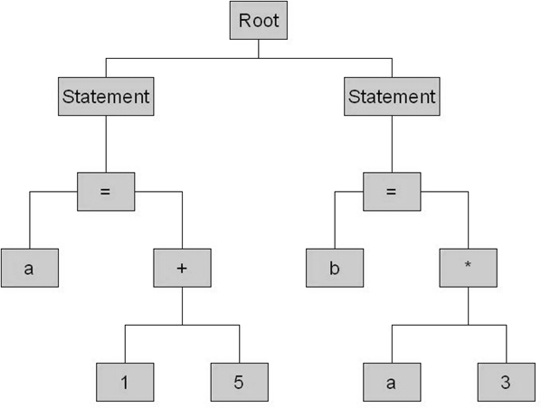
Internal representation
AST
Control flow graph
Data flow graph
Call graph
Dependency graph
...

Slide 6
Internal representation
AST
Control flow graph
Data flow graph
Call graph
Dependency graph
...

Slide 7
Internal representation
AST
Control flow graph
Data flow graph
Call graph
Dependency graph
...

Slide 8
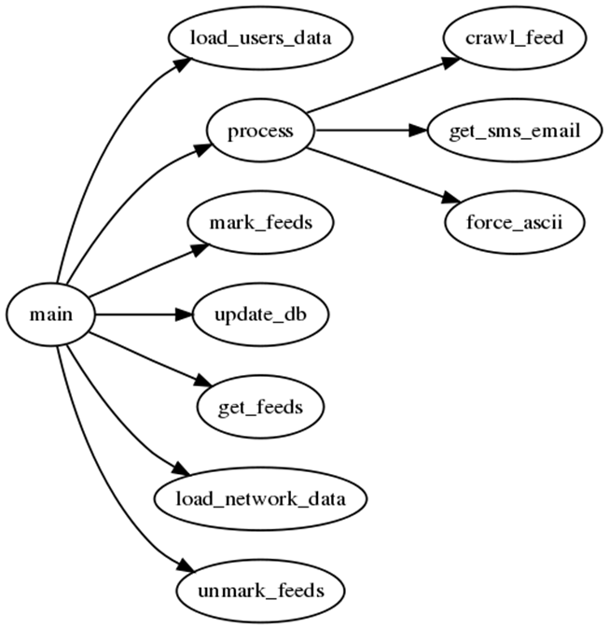
Internal representation
AST
Control flow graph
Data flow graph
Call graph
Dependency graph
...

Slide 9
Internal representation
AST
Control flow graph
Data flow graph
Call graph
Dependency graph
...

Slide 10
Internal representation
Oriented graph
Nodes are functional operators
Vertexes are data dependencies
Each operator stores:
  Operation name
  Input and output data links
  Meta data

Slide 11
Internal representation (branching)
Extended data flow model by Davis & Keller
Selector and Distributor represents conditional statements
Enough to represent any control operator
  If / Switch
  For / While

Slide 12
Optimizing transformations
• Constant folding;
• Sub-expression evaluation;
• Strength reduction;
• Null sequences;
• Combine operators;
• Loop optimizations;
• Branch Elimination;

Slide 13
Constant folding
Before
After

Slide 14
Sub-expression evaluation
Before
After

Slide 15
Dead code elimination
Before
After

Slide 16
Direct conversion
Before
After

Slide 17
Future plans
СIL processing (.NET assembly)
  Load
  Unload
  Compare results with MSFT .NET compiler
Static program analysis

Slide 18
Q&A

